Slide 1
Can You Predict Flight Delay?
cHUORAN wANG
2017.10.6

Slide 2
Flight Delay Reason
Notes:
Air Carrier: The cause of the cancellation or delay was due to circumstances within the airline's control (e.g. maintenance or crew problems, aircraft cleaning, baggage loading, fueling, etc.).
Extreme Weather: Significant meteorological conditions (actual or forecasted) that, in the judgment of the carrier, delays or prevents the operation of a flight such as tornado, blizzard or hurricane.
National Aviation System (NAS): Delays and cancellations attributable to the national aviation system that refer to a broad set of conditions, such as non-extreme weather conditions, airport operations, heavy traffic volume, and air traffic control.
Late-arriving aircraft: A previous flight with same aircraft arrived late, causing the present flight to depart late.
Security: Delays or cancellations caused by evacuation of a terminal or concourse, re-boarding of aircraft because of security breach, inoperative screening equipment and/or long lines in excess of 29 minutes at screening areas.

Slide 3
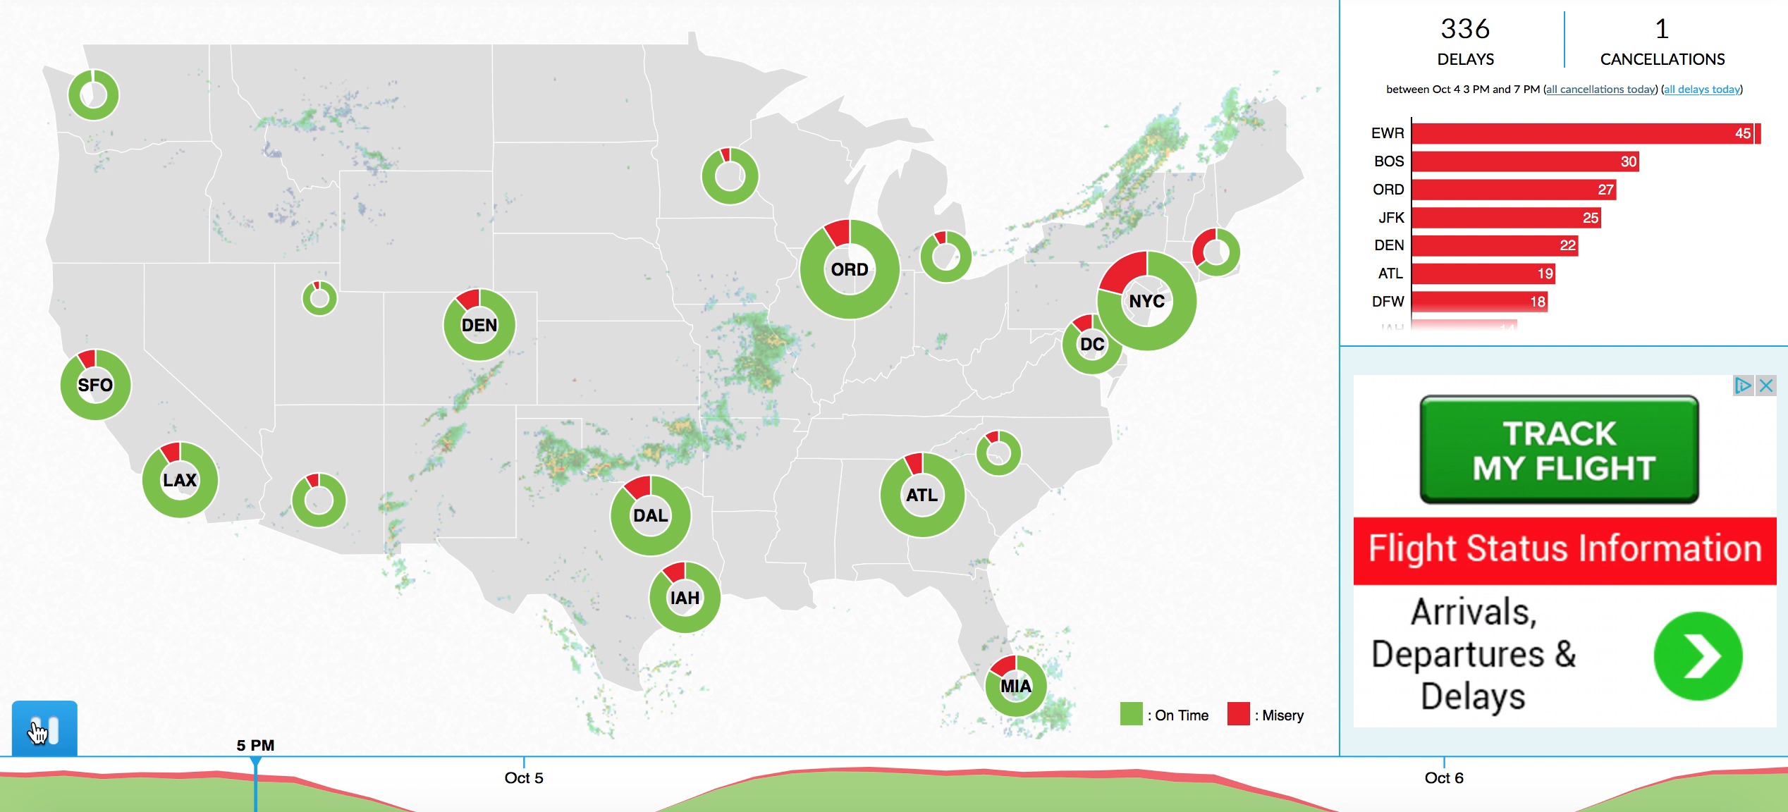
Flight Misery

Slide 4
Goal
We may suspect certain properties of flights may contribute to the flight delay
Airline companies
Airport
Flight departure and arrival time
Flight duration

Slide 5
Goal
Are they true?

Slide 6

Data and Scale
Identify Busy Airports
Flights within
Flight History
2015 top 20
passenger traffic
Nonstop only
Weeklong
Notes:
12k flights records

Slide 7
Raw Flight Information
Flight Number
Time
Schedule, Actual
Gate, Taxi, Takeoff/Landing
Flight
Distance
Speed
Altitude

Slide 8
Modeling – Framework
Variables - Anything that was planned out
Airline
Schedule time
Distance
Airports
Target – Things that actually happened
Departure delay, arrival delay, runway waiting time

Slide 9
Modeling – Feature and Target Setup
Categorical variables:
Airline – 6 major
Day of week
Time of day
Airport
Target variable choice
Departure, arrival, runway
Target scale
Real time, degree
Notes:
Delay_Arr
DAL -4.134888
UAL -2.726073
AAL -0.632399
JBU 0.358238
VRD 2.613793
SWA 2.934722

Slide 10
Modeling - Approach
Linear Regression
Normalization
Lasso
Random Forest Regression

Slide 11
Modeling - Findings
Delay time predictive power
 | Linear Regression | LR with Lasso | Random Forest | Random Forest – larger leaf
Arrival Delay Time | 0.006 | 0.007 | 0.05 | 0.04
Arrival Delay Level | 0.013 | 0.017 | 0.117 | 0.143
Departure Delay Level | 0.02 | 0.02 | 0.104 | 0.08

Slide 12
Modeling - Findings
Relative important features
flight duration (distance, duration)
airport scale
day of week
¯\_(ツ)_/¯
airline company
time of day

Slide 13
Future Work
More airports and airport information
Bigger difference
Passenger traffic
Whole network
Longer flight history
Incorporate events, holiday, weather
Detailed airline performance metrics

Slide 15
Notes:
indexDelay_Arr
DAL -4.134888
UAL -2.726073
AAL -0.632399
JBU 0.358238
VRD 2.613793
SWA 2.934722

Slide 16
Conclusions
Delay misery unpredictable with direct flight metrics
Difference exist
flight duration
airports

